Slide 1
Module 3: Treatment

Slide 2
Learning objectives
Understand the principles of TB treatment
Decide on the correct treatment regimen
Initiate children and adolescents with TB onto treatment
Manage children and adolescents diagnosed with drug-resistant TB
Notes:
Once we have made a decision to treat, we must be able to decide on the most appropriate treatment regimen.
We want to be able to initiate children and adolescents with TB onto treatment with high uptake and completion on correct dosages and the most suitable formulations.
We will also learn of the management of drug-resistant TB in children and adolescents.

Slide 3
Outline
Introduction and principles of treatment
Treatment regimens
RR/MDR-TB treatment
Case study quiz
Conclusion
Challenge your knowledge
Notes:
This is the outline of what we will cover in this module.
We start with an introduction and cover the principles of TB treatment in children and adolescents.
We will go through the main regimens that are used and touch on the treatment of drug-resistant TB
Towards the end, there will be a case study quiz.
We’ll conclude the module with a summary of key points for you to take away.

Slide 4
Outline
Discussion
Introduction and principles of treatment
Treatment regimens
RR/MDR-TB treatment
Case study quiz
Conclusion
Challenge your knowledge
Discussion
Notes:
There will also be a couple of opportunities to share some of your own country specific setting practices on the discussion forum.

Slide 5

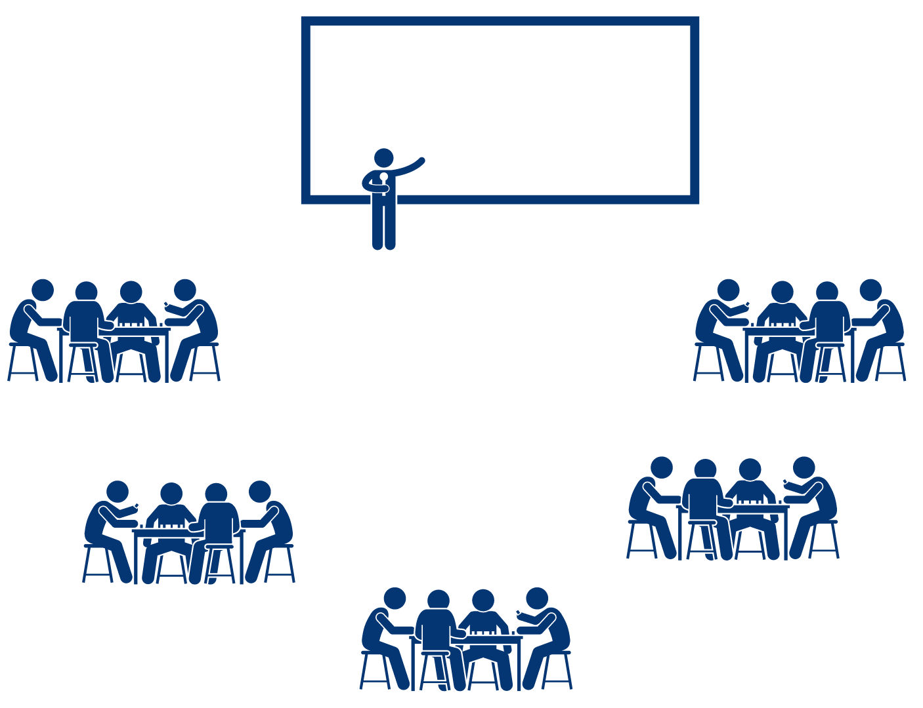
Discussion – setting specific practices
Note to facilitator:
Suggested instructions:
These context specific discussion opportunities will occur repeatedly throughout this training. Here are some suggestions on how you might like to facilitate them, to run them in a time efficient manner.
Explain that the next 15 minutes will be devoted to sharing amongst your colleagues, about how things may work in your setting.
Explain that 3, or 4, questions will be shown on the presentation.
Then divide the questions amongst the groups. Some groups may need to discuss the same question.
Tell them they will have just 2 or 3 minutes to discuss in their small groups. Then you will discuss as a large group.
Allow 2-3 minute discussion time.
When this time is up, ask for everyone’s attention. And then ask for volunteers to comment on each question discussed. Request participants to keep their responses succinct so that the time allows for others to also contribute.
Acknowledge all responses and thank participants for sharing.
Be mindful of the time and try to wrap up discussions so that the full activity takes no more than 15 minutes.
Click for audible instructions
To discuss Question 1
To discuss Question 4
To discuss Question 2
To discuss Question 3
Notes:
These context specific discussion opportunities will occur repeatedly throughout this training.
Here are some suggestions on how you might like to facilitate them, to run them in a time efficient manner.
Explain that the next 15 minutes will be devoted to sharing amongst your colleagues, about how things may work in your setting.
Explain that 3, or 4, questions will be shown on the presentation.
Then divide the questions amongst the groups. Some groups may need to discuss the same question.
Tell them they will have just 2 or 3 minutes to discuss in their small groups. Then you will discuss as a large group.
When this time is up, ask for everyone’s attention. And then ask for volunteers to comment on each question discussed. Request participants to keep their responses succinct so that the time allows for others to also contribute.
Acknowledge all responses and thank participants for sharing.
Be mindful of the time and try to wrap up discussions so that the full activity takes no more than 15 minutes.

Slide 6
Discussion: setting-specific practices
What are the main challenges you face in providing correct treatment for children and adolescents with TB?
1
Are there situations where children and adolescents diagnosed with TB are not started on TB treatment and if so, how can this be addressed?
2
What are the main reasons for poor adherence to TB treatment?
3

Slide 7
What are the main challenges you face in providing correct treatment for children and adolescents with TB?
1
Are there situations where children and adolescents diagnosed with TB are not started on TB treatment and if so, how can this be addressed?
2
What are the main reasons for poor adherence to TB treatment?
3

Slide 8
Introduction and principles of treatment

Slide 9

Aims of TB treatment
Cure the patient of TB.
Prevent death or long-term health effects from TB disease.
Reduce transmission of TB bacilli to others.
Prevent relapse of TB.
Prevent the development of drug-resistant TB.
Achieve all of the above with minimal toxicity.
Notes:
The aims for TB treatment are to cure the TB disease which will prevent death from TB disease or reduce the likelihood of long-term impact on health. In addition to individual health outcomes, effective treatment of TB will quickly reduce transmission of TB to others – this is particularly important in adolescents as young children with TB are much less likely to transmit disease. The treatment regimen should also prevent relapse and the development of drug-resistant TB. We aim to achieve all of this while causing minimal toxicity to the patient.

Slide 10






Guiding principles of TB treatment in children
Caregiver education and counseling at the time of treatment initiation is key.
TB drugs are usually very well tolerated at recommended dosages by children.
Dosages are calculated according to weight, not by age.
Children with TB usually respond well with symptomatic improvement during intensive phase.
Treatment outcomes are usually excellent in children.
Adverse events among children are unusual at recommended dosages.
Notes:
Listed here are some guiding principles of treatment of disease or infection in children. Treatment completion and safety are critical but it can take many months of daily medication for TB treatment or TPT to be effective.
Therefore, education and counseling to the child as well as to the caregiver at the time of treatment initiation is key for adherence and treatment completion
It is very helpful to reassure patients and families that the drugs for TB are usually well tolerated in almost all children as long as given at correct recommended dosages.
Weight is important as dosages are calculated according to weight, not by age, and sometimes dosages have to be adjusted with changes of weight during follow-up.
Children with TB respond well to treatment often with symptomatic improvement during intensive phase so important to explain that the whole course needs to be completed. Treatment outcomes are usually excellent as long as treatment is taken to completion and adverse effects due to the drugs are ususual in children – the main serious one in treatment of drug-susceptible TB is hepatotoxicity but this is very rare if correct dosages are used.

Slide 11






Guiding principles of TB treatment in adolescents
Treatment of TB in adolescents follows the same principles as in adults.
Psychosocial education and counseling at the time of treatment initiation is key for adherence and treatment completion.
Consider age, developmental stage and social history to provide optimal support – and listen.
Adolescents have additional challenges for care and outcomes that include adherence and stigma.
TB drugs are generally well tolerated in adolescents.
Adolescents can be treated with the same formulations as adults.
Notes:
Treatment of TB in adolescents follows the same principles as in adults, Psychosocial education and counseling at the time of treatment initiation is especially key for adherence and treatment completion as adolescents have particular age-related challenges for care and outcomes - including adherence, stigma, attention to ongoing education needs, treatment autonomy - and therefore require supportive monitoring and follow-up in the context of their age, development stage and social circumstances.
First-line TB drugs are generally well tolerated in adolescents but more similar to adults, with non-severe side-effects more commonly reported than for young children.
Adolescents can be treated with the same formulations as adults

Slide 12

Approach to diagnosis and treatment decision
Important questions in the assessment include:
Does the child or adolescent require inpatient care?
Is the child at risk for severe TB disease?
If TB diagnosed, the choice of treatment regimen will be based on:
  SITE of disease
  AGE
  SEVERITY of disease
  DRUG-SUSCEPTIBILITY
  (presumptive or confirmed)
Notes:
Before we move to choice of treatment regimen, let’s review some of the considerations that will effect decision to treat and what to treat with.
Approaches to evaluation and management decisions include:
assess severity of illness that may require immediate management and further investigation for TB;
evaluate nutritional status and risk evaluation for TB disease on basis of age and comorbidities such as HIV or severe malnutrition;
results of bacteriological tests and chest X-ray findings with consideration of disease site, disease severity and drug susceptibility as all these will impact on choice of treatment regimen

Slide 13
Additional considerations for treatment
Ensure prompt treatment initiation for TB.
Pyridoxine supplements especially if malnourished or living with HIV.
Nutritional support with advice for all.
Consider corticosteroids – indicated for:
  TB meningitis
  Pericardial TB
  Airway obstruction or if other pressure effect such as spinal TB
  Immune reconstitution inflammatory syndrome (IRIS)
Management of comorbidities – severe malnutrition, HIV, anaemia.
Treatment support with age-appropriate education and counselling – Module 5.
Notes:
Once a child or adolescent has been diagnosed with TB and the appropriate recommended regimen chosen, then treatment should be ensured and initiated without delay. Pretreatment loss to follow-up is not uncommon especially in adolescents or adults who submit a sample for laboratory diagnosis but are not initiated on treatment even when the test is positive. This is likely less common in young children but prompt treatment is especially critical in this age as they can deteriorate quickly if untreated.
There are additional issues to consider that are listed. Nutritional advice and support should be provided along with pyridozine supplementation if receiving isoniazid, especially if malnourished or living with HIV. Nutritional support has been shown to improve outcomes.
Corticosteroids are indicated from initiation of treatment for TB meningitis and pericardial TB, but also are useful to reduce the inflammatory response to TB that can cause compression (e.g. of airway or spinal cord) or that occurs after TB treatment is commenced. TB IRIS with worsening of symptoms can occur within weeks after treatment initiation following initial improvement, especially in children with severe malnutrition or HIV who are very immunosuppressed.
The effective management of any comorbidity is critical to optimize treatment outcome as is comprehensive treatment support to ensure adherence and completion. We revisit this in module 5.

Slide 14
Treatment regimens
Notes:
We will now cover the main treatment regimens for confirmed or presumed drug-susceptible TB. Note that you should check and follow NTP treatment guidelines.

Slide 15

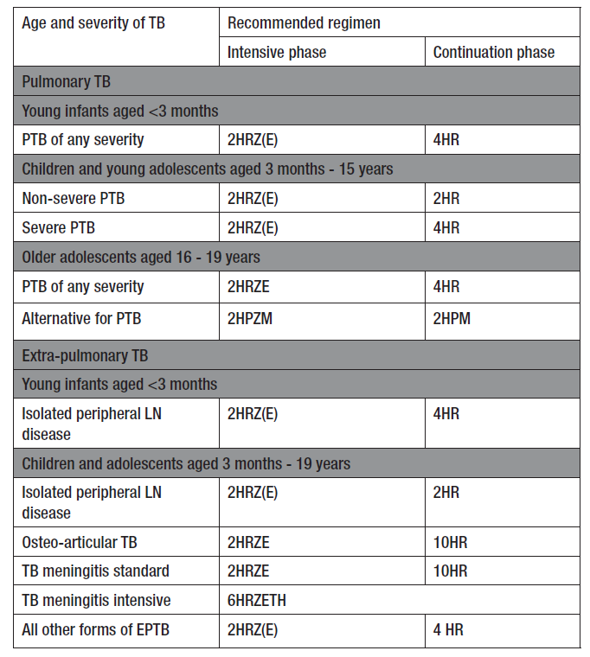
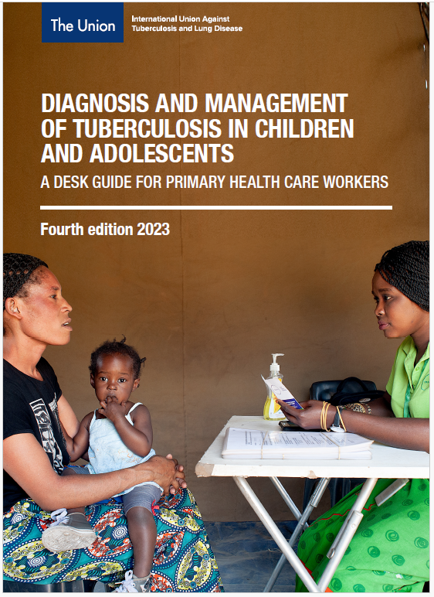
Recommended DS-TB treatment regimens by site, age and severity
ADULT &
CHILD
ADAPT TO LOCAL SETTING
Example
H - isoniazid
R - rifampicin
Z - pyrazinamide
E - ethambutol
Notes:
The Union’s desk guide for primary healthcare workers lists recommended regimens by age as well as by site of disease and severity. Healthcare workers should have ready access to such information.
This is just an example and useful for hcw to have an easy reference to refer to but be sure that is consistent with national guidelines – may be replaced with national guidelines box

Slide 16

Choice of treatment regimen
The choice of treatment regimen will be based on:
  SITE of disease
  AGE
  SEVERITY of disease
  DRUG-SUSCEPTIBILITY
  (presumptive or confirmed)
? Young infant < 3 m or older adolescents > 15 yrs
If not known for child, consider index case.
PTB or EPTB?
If EPTB: consider specific site such as lymph node, CNS, osteoarticular
  Consider:
  Bacillary load (laboratory results)
  Radiological severity
  Multiple sites

Slide 17
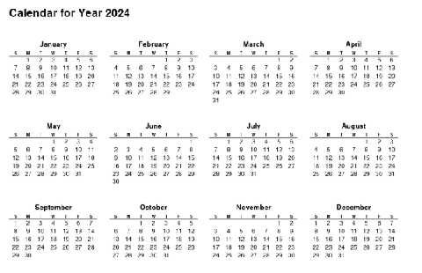
Choice of treatment regimen - non-severe
ADULT &
CHILD
ADAPT TO LOCAL SETTING
A four-month regimen - 2HRZ(E)/2HR
is a recommended option for children between 3 months and 16 years
to treat non-severe forms of drug-susceptible TB, defined as:
Paucibacillary TB
Uncomplicated pulmonary TB on CXR:
Lymph node TB that is peripheral
and isolated
Sputum smear-negative
or
Negative, trace, or low MTB detection on Xpert Ultra
Lymph node enlargement without airway obstruction
Non-cavitary disease
Confined to less than one full lobe of the lungs; and
Uncomplicated TB pleural effusion
Without miliary pattern
Notes:
A four-month treatment regimen - 2HRZ(E) 2HR - is now recommended by WHO for non-severe forms of presumptive drug-susceptible TB in children of 3 months and older that is paucibacillary TB – meaning smear-negative or low MTB detection on Xpert Ultra – and that on CXR, does not have airway obstruction due to lymph node enlargement, does not have cavities, any parenchymal disease is confined to less than one full lobe of the lungs and there is no a miliary pattern. Non-severe forms of EPTB that can be treated with a four-month regimen are lymph node TB that is peripheral (e.g., neck swelling) and isolated (i.e., no evidence of TB elsewhere) or uncomplicated TB pleural effusion
(NOTE: this may need to be adapted to be consistent with national guidelines)

Slide 18
Choice of treatment regimen – severe
ADULT &
CHILD
ADAPT TO LOCAL SETTING
The six-month treatment regimen of 2RHZ(E)/4RH is for
presumed or confirmed drug-susceptible TB if:
Severe pulmonary TB including:
A high bacterial load - always includes four drugs in the intensive phase (2HRZE)
i.e. smear-positive result or Xpert MTB/RIF Ultra result greater than “low”
A young infant
(< 3 months)
with pulmonary or lymph node TB irrespective of severity
Lymph node enlargement with airway compression
Cavitations
Extensive lung disease with one full lobe or more involved on CXR
Miliary pattern
Notes:
The standard six-month treatment regimen should be used for severe pulmonary TB that is confirmed or presumed to be drug-susceptible. Severe pulmonary TB on CXR includes intrathoracic lymph node enlargement with airway compression, cavitations or extensive lung disease with more than one lobe involved on CXR. The standard 6-month regimen is also used in young infants (<3 months).
Note that a fourth drug, ethambutol, should be included in the intensive phase of the 6-month regimen when disease has a high bacterial load - sputum smear-positive TB or high-level detection of MTB on Xpert. The main role of ethambutol is to protect against the development of resistance during treatment.
Note that ethambutol is also recommended by WHO to be used as the fourth drug in the standard intensive phase for both severe and non-severe forms of TB and extra-pulmonary TB (except TB meningitis) in high HIV prevalence or high isoniazid-resistance settings. It is also recommended for infants aged less than 3 months of age in these settings.
(NOTE: this may need to be adapted to be consistent with national guidelines)

Slide 19
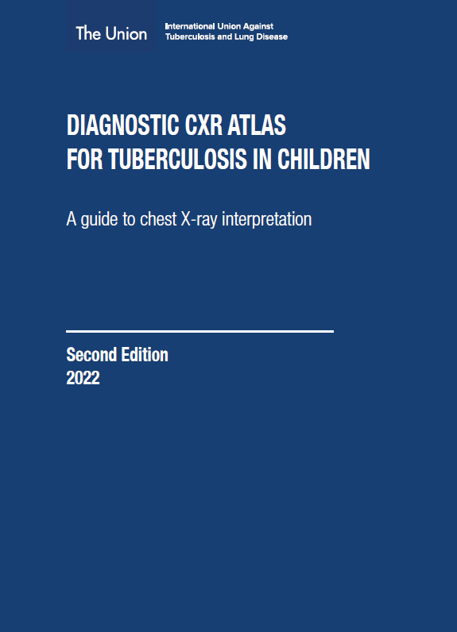
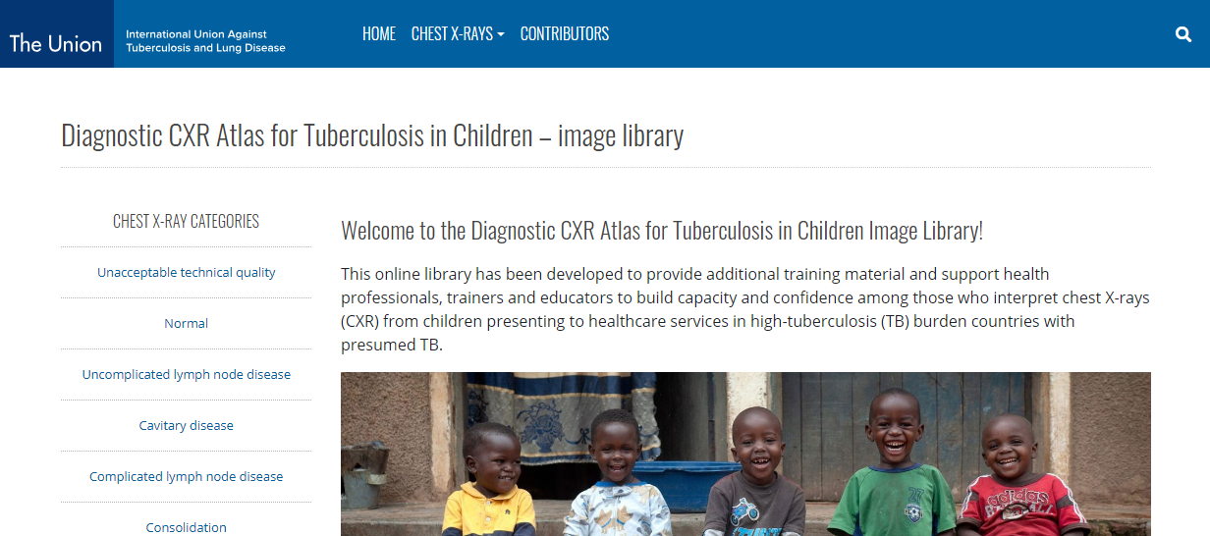
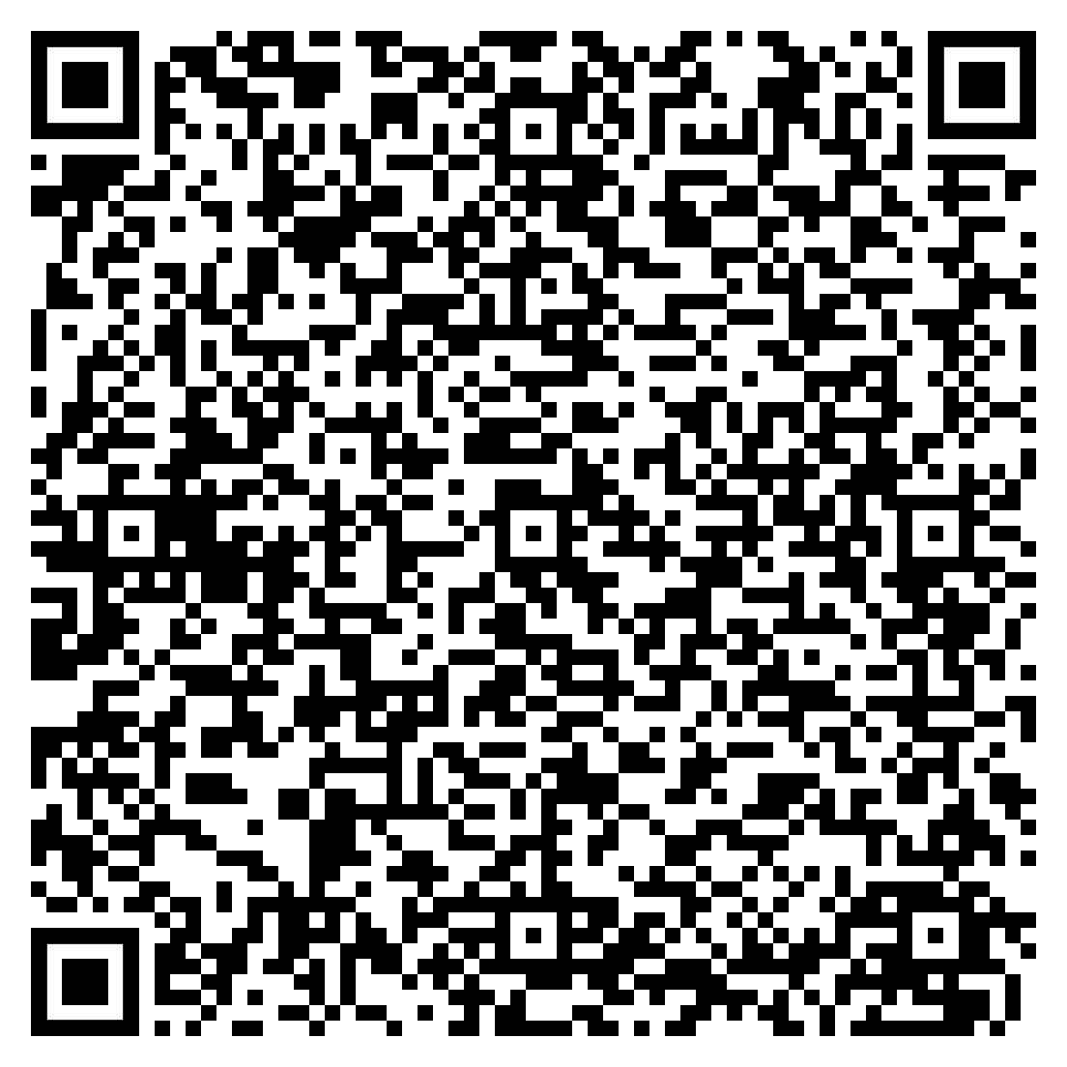
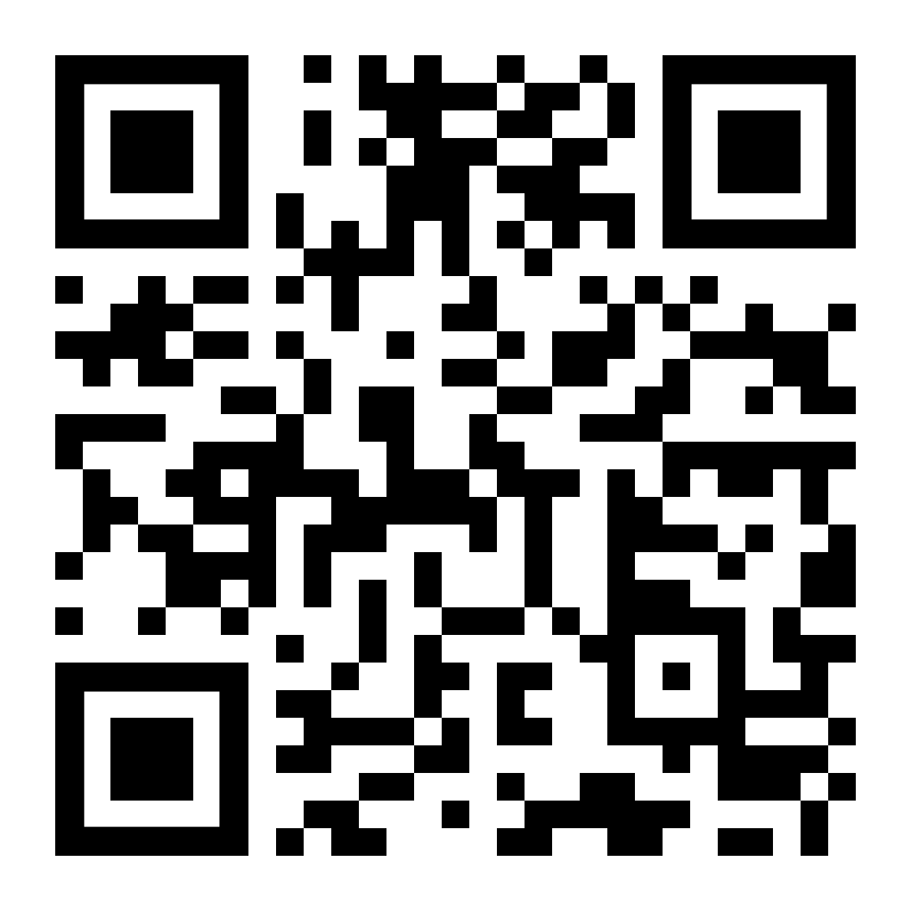
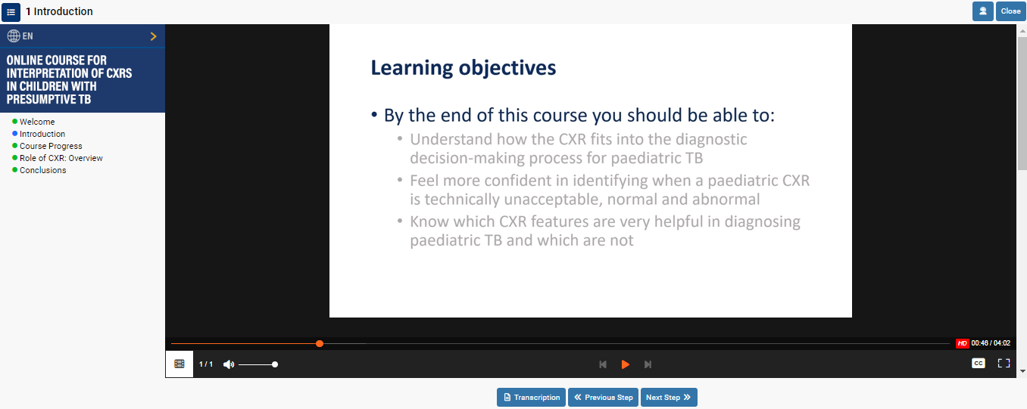
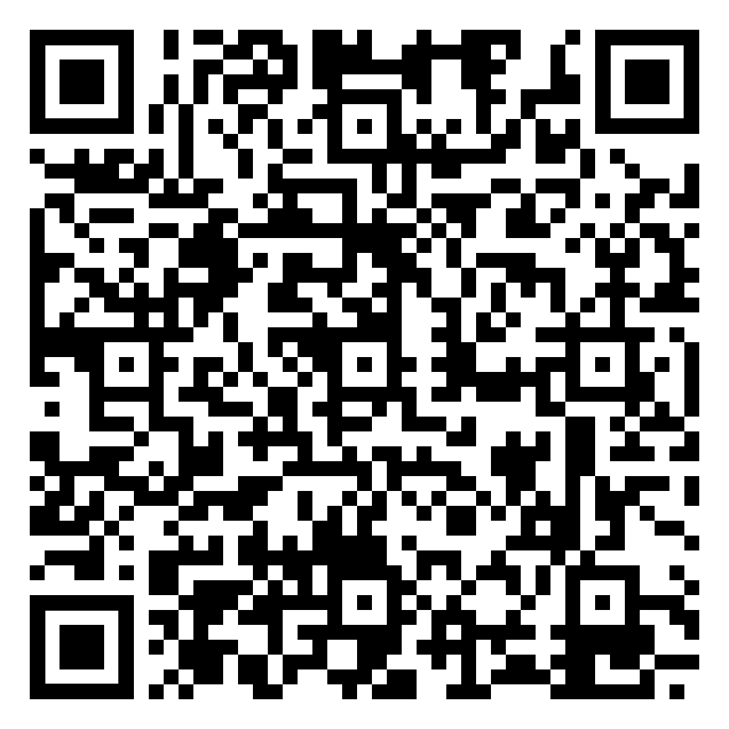
Choice of treatment regimen – CXR features
Online course on interpretation of CXR in children with presumptive TB
The Union’s Online Diagnostic CXR atlas – image library
The Union’s Diagnostic CXR atlas
Notes:
The Union’s Diagnostic CXR atlas and on-line CXR training course provide examples of severe and non-severe TB as seen on CXR. This example would be classified as severe because the obvious lymph node enlargement is complicated by airway narrowing, which is not so obvious. This highlights the challenges as using CXR to determine severity requires good quality, inspiratory radiographs as well as some expertise or experience in interpreting abnormal findings. If in doubt, treat for 6 months.

Slide 20
CXR for assessment of SEVERITY of disease
Is the quality of the CXR technically acceptable?
Yes
No
Is the CXR normal?
Do not interpret
the CXR.
Repeat CXR.
No
Yes
Are there CXR features that are very specific to TB?
(e.g. intra-thoracic lymphadenopathy, miliary pattern, pleural effusion, cavities)
TB disease unlikely.
Yes
No
TB disease very likely.
Collect sample and start TB treatment: decide on disease severity.
Review all other information to decide about the possibility of TB disease.
Radiologically severe
Radiologically
non-severe
Source: The Union. Diagnostic CXR atlas for tuberculosis in children. A guide to chest X-ray interpretation. 2nd ed. Paris, France. 2022. 94p.
Notes:
There is a systematic approach nicely illustrated in the Union’s CXR Diagnostic Atlas that is a useful guide. The steps are first to decide whether the CXR is of sufficient quality and if it is, then whether normal or abnormal. If abnormal, are the abnormalities TB-related or consistent with TB – and then once decided to treat, need to determine severity on CXR of pulmonary or pleural TB to decide on duration of treatment. Other abnormalities such as miliary TB or pericardial TB require other treatment decisions.

Slide 21
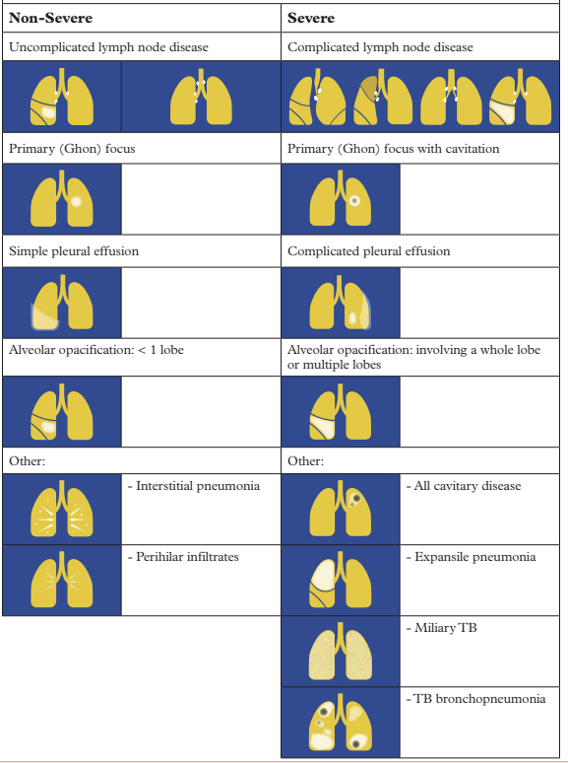
Assessing severity
Notes:
The Union’s Diagnostic CXR atlas and on-line CXR training course provide examples of severe and non-severe TB as seen on CXR. This example would be classified as severe because the obvious lymph node enlargement is complicated by airway narrowing, which is not so obvious. This highlights the challenges as using CXR to determine severity requires good quality, inspiratory radiographs as well as some expertise or experience in interpreting abnormal findings. If in doubt, treat for 6 months.

Slide 22
Using CXR to determine severity
ANY ‘Yes’ indicates severe
Study the Xray to exclude severe features:
✗
Is there significant airway compression or deviation?
Is there consolidation ≥ 1 full lobe?
Are there cavities?
Are there miliary infiltrates?
Is there a complicated pleural effusion?
YES
NO
✗
YES
NO
✓
✗
YES
NO
✗
YES
NO
✗
YES
NO
ALL ‘No’ indicates
non-severe

Slide 23
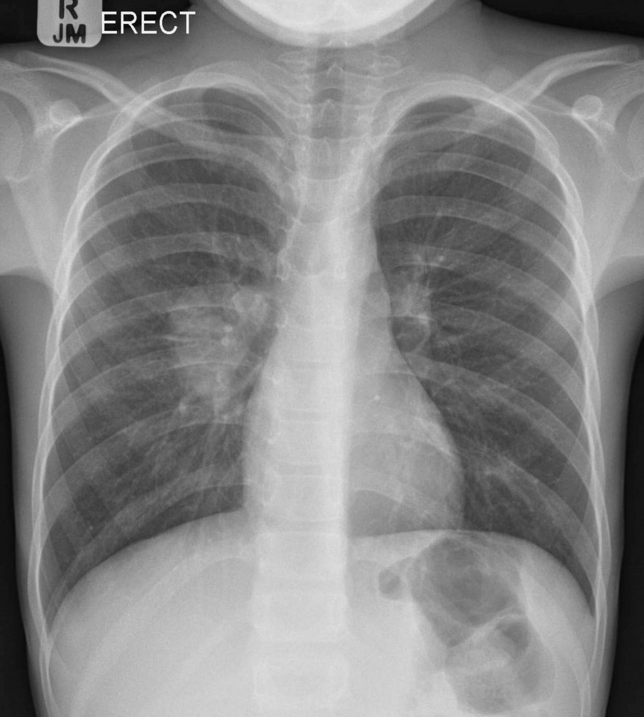
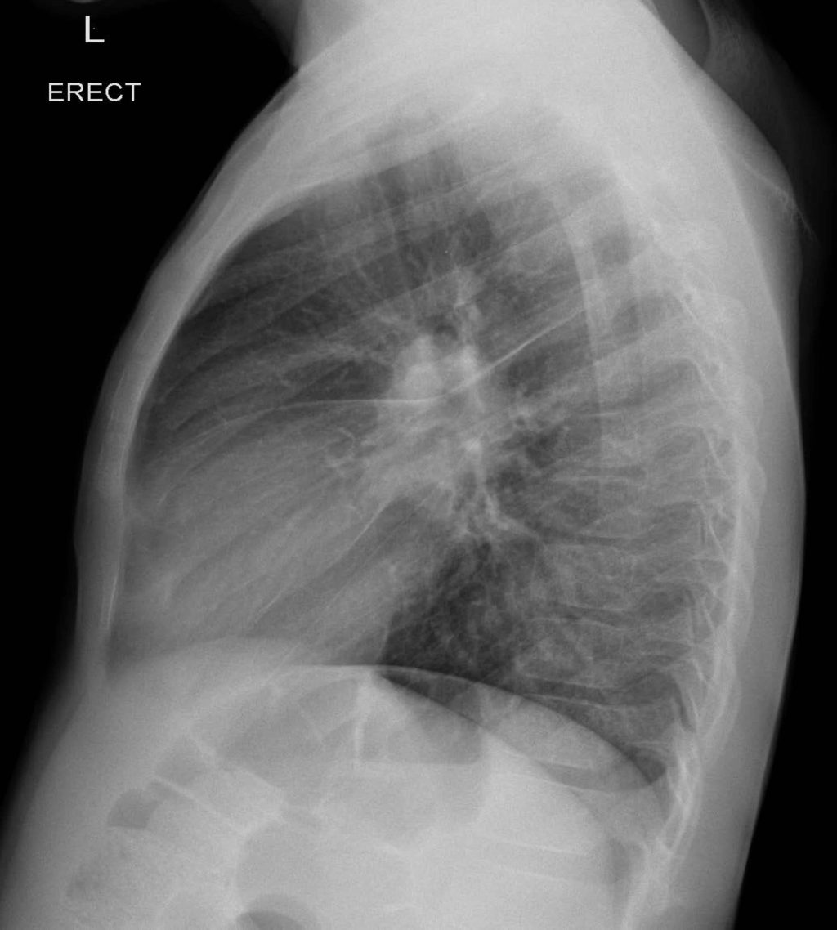
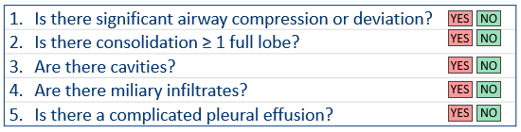
CXR - non-severe pulmonary TB
Note to facilitator:
Suggested instructions:
These next few slides are set to animate elements on the slides as you talk when you are in slide show presenter mode. It is useful to follow the script in the notes section for these slides, as they will tell you when to click to trigger an animation. For instance, the first click will bring in the yellow shaded section showing the right perihilar lymph nodes. We recommend you practise these a couple of times so that you know what to expect.
Click for audible instructions
Lymph node enlargement with no opacification or opacification limited to one lobe
No narrowing of airways
Enlarged right perihilar lymph node with no involvement of the airways or lung parenchyma
✗
✗
✗
✗
✗
Notes:
This slide has examples from the Atlas of non-severe lymph node enlargement seen in the right perihilar region – the commonest CXR abnormality seen with TB in young children.
[Click for animation] – here you can see the enlarged right perihilar lymph nodes.
[Click for animation] – here you can see them on the lateral
[Click for animation] - let’s run through the checklist for this Xray together:
Is there significant airway compression or deviation? [Click for animation] …No
Is there consolidation ≥ 1 full lobe? [Click for animation] …No
Are there cavities? [Click for animation] …No
Are there miliary infiltrates? [Click for animation] …No
Is there a complicated pleural effusion? [Click for animation] …No
There we can consider this [Click for animation] non-severe TB.

Slide 24
CXR - non-severe pulmonary TB
Lymph node enlargement with no opacification, or opacification limited to one lobe
Enlarged right paratracheal lymph node
Parenchymal abnormality in upper segment of right lower lobe
✗
✗
✗
✗
✗
Notes:
Here is another example of non-severe lymph node enlargement with parenchymal abnormality in an upper segment of the right lower lobe.
[Click for animation] – here we see the enlarged right paratracheal lymph node
[Click for animation] – here we see parenchymal abnormality in upper segment of right lower lobe
[Click for animation] - let’s run through the checklist for this Xray together:
Is there significant airway compression or deviation? [Click for animation] …No
Is there consolidation ≥ 1 full lobe? [Click for animation] …No
Are there cavities? [Click for animation] …No
Are there miliary infiltrates? [Click for animation] …No
Is there a complicated pleural effusion? [Click for animation] …No
There we can consider this [Click for animation] non-severe TB.

Slide 25
CXR – severe pulmonary TB
Lymph node enlargement with airway compression
Narrowing of the left main bronchus
Opacity that fills the posterior inferior quadrant
✓
✗
✗
✗
✗
Notes:
This example shows Lymph node enlargement with airway compression.
Although enlarged lymph nodes are not obvious on the AP film,
[Click for animation] there is narrowing of the left main bronchus, which is not so obvious.
The enlarged lymph nodes are more apparent on the lateral film –
[Click for animation] note how the opacity on the lateral CXR includes the posterior inferior quadrant space.
[Click for animation] - If we go through the checklist for this Xray together:
Is there significant airway compression or deviation? [Click for animation] …yes – remember we only need 1 ‘Yes to fulfil the criteria for severe.
So even though there are no other criteria here [Click for animation] this is considered radiologically severe disease.

Slide 26
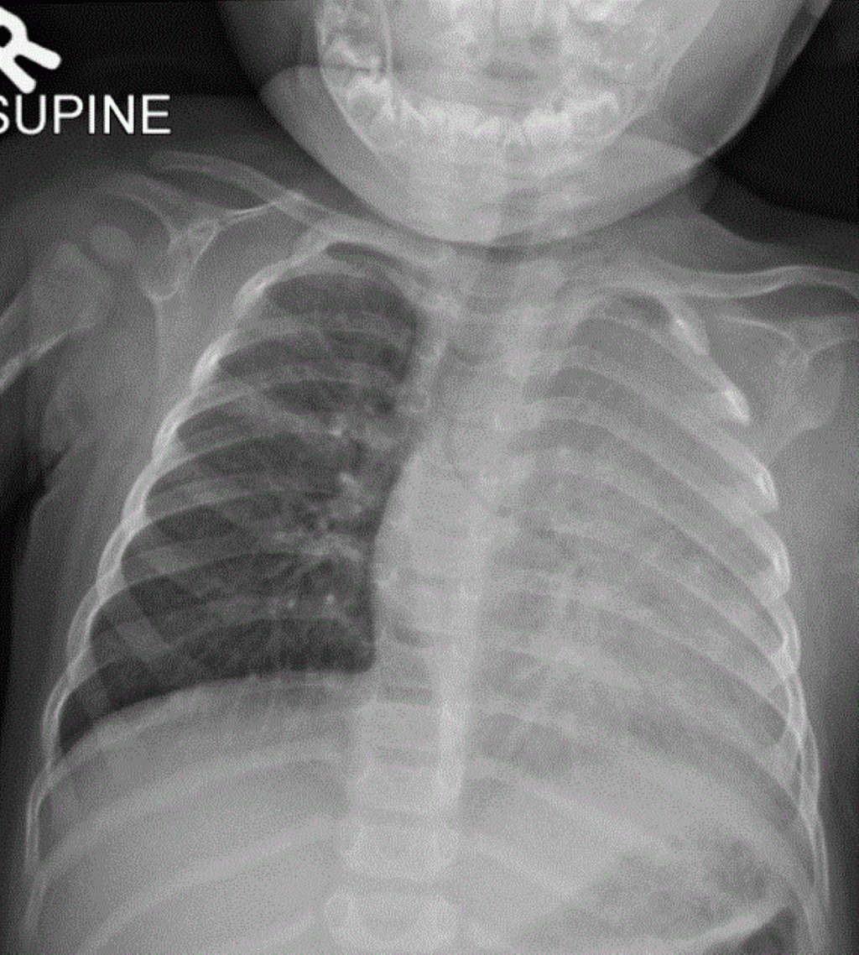
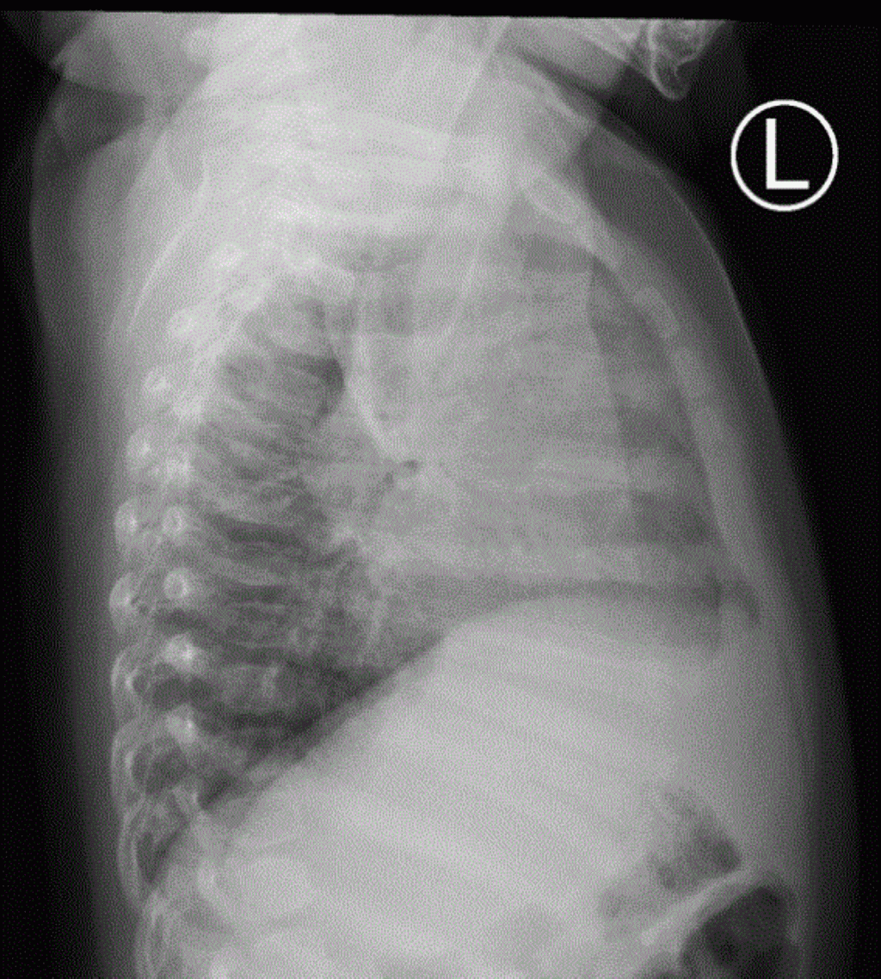
CXR – severe pulmonary TB
Airway compression and more than one full lobe involved
Narrowing of the left main bronchus
LUL
Dense consolidation of the entire left lung
LLL
✓
✓
✗
✗
✗
Notes:
Here is another example of airway compression with more than one lobe involved.
[Click for animation] Note the dense consolidation of the entire left lung. Also seen on lateral.
[Click for animation] The left main bronchus is narrow – this is likely caused by enlargement of perihilar and subcarinal lymph nodes (even though you cannot see the lymph nodes).
[Click for animation] - let’s run through the checklist for this Xray together:
Is there significant airway compression or deviation? [Click for animation] …Yes
Is there consolidation ≥ 1 full lobe? [Click for animation] Yes
Are there cavities? [Click for animation] …No
Are there miliary infiltrates? [Click for animation] …No
Is there a complicated pleural effusion? [Click for animation] …No
So this is considered [Click for animation] severe disease.

Slide 27

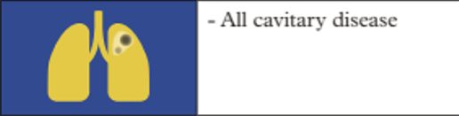
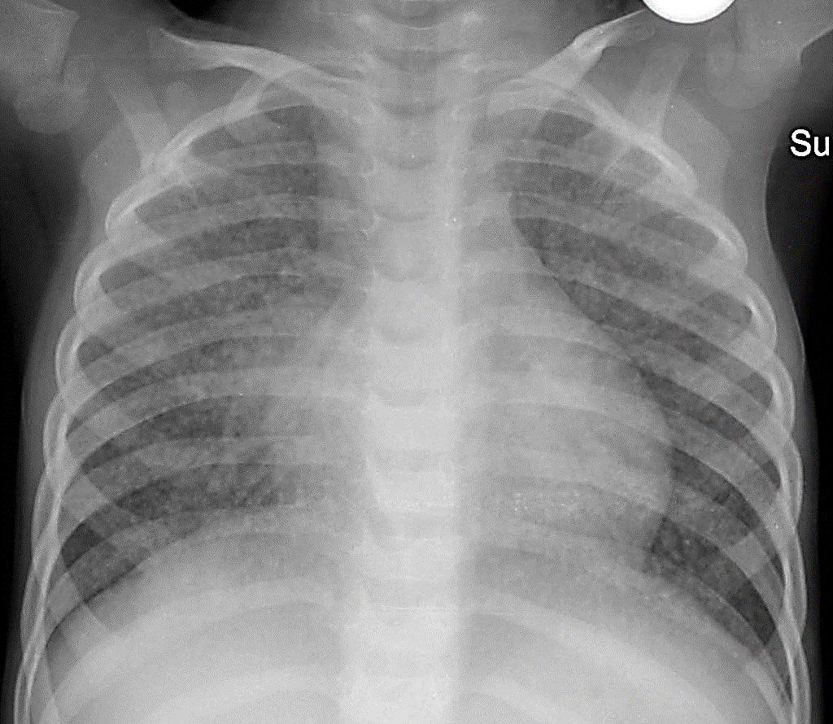
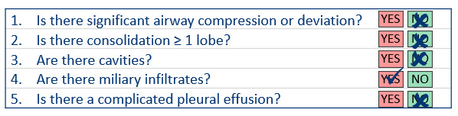
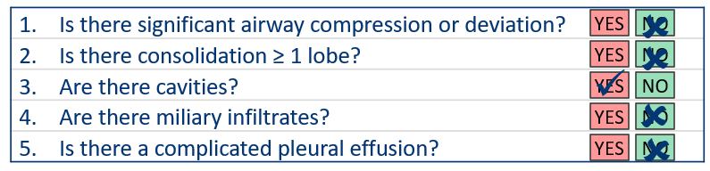
CXR – severe pulmonary TB
Multiple millet sized nodules distributed throughout both lung fields.
Multiple cavities
Miliary pattern
Cavitation
Notes:
Here are some more examples of severe pulmonary TB that require 6 months of treatment.
[Click for animation]
Miliary pattern – with multiple millet sized nodules distributed throughout both lung fields.
[Click for animation] And cavitary disease- note the right middle lobe opacification with breakdown and cavity formation.
These are radiologically severe disease.

Slide 28
Recommended DS-TB treatment regimens by site, age and severity
ADULT &
CHILD
ADAPT TO LOCAL SETTING
Example
What is SITE of disease?
PULMONARY TB
EXTRA-PULMONARY TB
AGE of child or adolescent:
AGE of child or adolescent:
< 3 months old
3 months – 15 years old
16-19 years old
< 3 months old
3 months – 19 years old
Manage further according to SEVERITY:
Manage further according to SEVERITY
2HRZ (E)* + 4HR
2HRZE + 4HR
Or
2HPZM + 2HPM
2HRZ (E)* + 4HR
Non-severe
Severe
Non-severe PTB
Severe
PTB
Isolated peripheral LN disease
Osteo-articular
TB
TBM
All other forms of EPTB
2HRZ (E) * + 2HR
2HRZ (E) * + 4HR
Standard
Intensive
2HRZ (E) * + 2HR
2HRZE + 10HR
6HRZEto
2HRZ (E)* + 4HR
(E)* = include as standard TB treatment in settings with a high prevalence of HIV or of isoniazid resistance.
Always follow up DST result.
Adjunct steroids: initiate corticosteroids in TBM. Steroids also indicated for: pericardial, spinal (sometimes), airway obstruction, TB-IRIS.
Notes:
This is a nice summary example of how regimen selection is determined by site of disease, age of child or adolescent, and possibly by severity of disease for some forms of TB. All options currently recommended by WHO are listed. (NOTE: this may need to be adapted to be consistent with national guidelines)
Corticosteroid treatment is indicated with the initiation of treatment for TBM as indicated – but also for pericardial TB, lymph node enlargement causing airway obstruction, spinal TB causing spinal compression.

Slide 29
Other treatment regimens – children
ADULT &
CHILD
ADAPT TO LOCAL SETTING
Treatment options for TB meningitis
Osteoarticular TB, which includes
spinal TB, presumed to be drug-susceptible
Option ❶
Option ❷
Intensive regimen of four drugs for 6 months:
6HRZEto
With higher dosages of isoniazid and rifampicin than for standard regimen as well as ethionamide (or levofloxacin) replacing ethambutol.
Standard regimen of 12 months
– 2HRZE/10HR
Include ethambutol if:
Pulmonary TB with a high bacterial load
Severe forms of extra-pulmonary TB except TB meningitis
Standard TB treatment in settings with a high prevalence of HIV or of isoniazid resistance
H – isoniazid | R – rifampicin | Z – pyrazinamide | E – ethambutol | Eto – ethionamide
Notes:
Let’s just briefly touch on other new recommended regimens. There are now two recommended regimens for TB meningitis, An intensive regimen of four drugs daily for six months - 6HRZEto – with higher dosages of isoniazid and rifampicin than for standard regimen as well as ethionamide (or levofloxacin) replacing ethambutol. Ethambutol does not cross the blood brain barrier so it has no value for TBM and rifampicin only crosses sufficiently when the dosages are high.
The standard 12 months regimen can still be used for TB meningitis, and is recommended for osteoarticular TB, which includes spinal TB.
As mentioned already, the addition of ethambutol in the intensive phase is recommended for pulmonary TB with a high bacterial load, for severe forms of extra-pulmomary TB except TB meningitis and a standard TB treatment in settings with a high prevalence of HIV or of isoniazid resistance

Slide 30
Recommended TB treatment regimens for PTB by age
Regimen | Age
 | 0 – 3 months | 3 months – 10 years | 3 months – 10 years | 10 – 12 years | 12- 16 years | > 16 years
2HRZ(E)/4HR | Ethambutol in intensive phase is recommended in: children or adolescents with multibacillary disease those living with HIV settings with a high background prevalence of isoniazid resistance or HIV infection
2HRZ(E)/2HR | Not recommended |  | Non-severe TB, > 3kg, add ethambutol in settings with a high background prevalence of isoniazid resistance or HIV infection or in CALHIV. |  |  | Not recommended
2HPMZ/2HPM | Not recommended |  |  |  | Independent of disease severity or HIV status
Additional factors to be considered if several regimens are possible |  |  | Disease severity
 | Patient or family preference
 | Access and cost of regimen component drugs
Notes:
Always check and follow national TB treatment guidelines. Here is an example that shows information for choice of regimen by age.

Slide 31
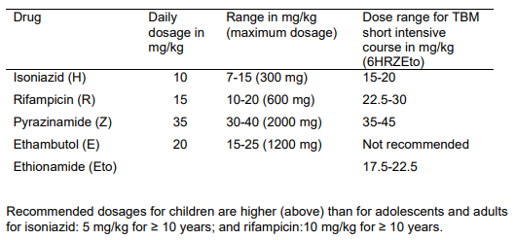
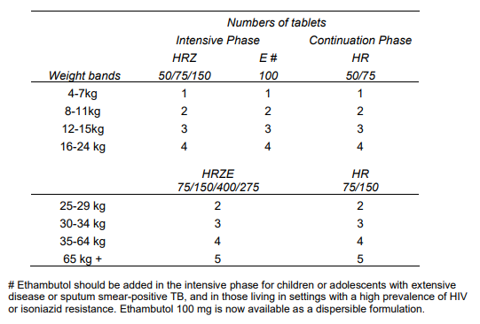
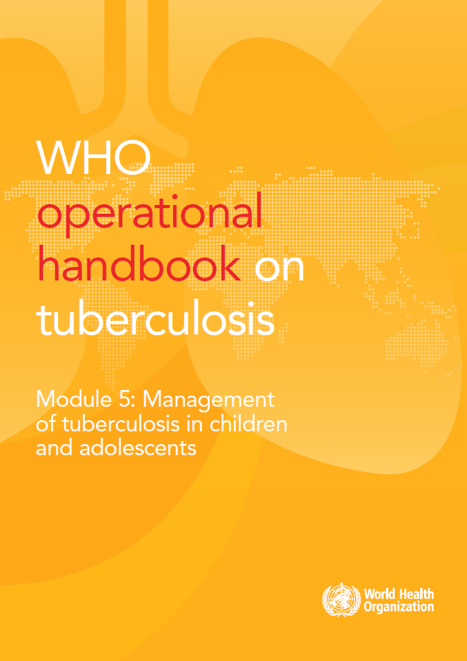


Recommended dosages by weight
Drug | Daily dosage in mg/kg | Range in mg/kg (maximum dosage) |  | Dose range for TBM short intensive course in mg/kg (6HRZEto)
Isoniazid (H) | 10 | 7-15 (300mg) |  | 15 – 20
Rifampicin (R) | 15 | 10-20 (600mg) |  | 22.5 – 30
Pyrazinamide (Z) | 35 | 30-40 (2000mg) |  | 35 – 45
Ethambutol (E) | 20 | 15-25 (1200mg) |  | Not recommended
Ethionamide (Eto) |  |  |  | 17.5 – 22.5
Recommended dosages for children are higher (above) than for adolescents and adults for isoniazid: 5mg/kg for ≥ 10 years; and rifampicin: 10mg/kg for ≥ 10 years.
 | Numbers of tablets
 | Intensive phase |  | Continuation phase
Weight bands | HRZ 50/75/150 | E# 100 | HR 50/75
4 – 7kg | 1 | 1 | 1
8- 11kg | 2 | 2 | 2
12 - 15kg | 3 | 3 | 3
16 – 24kg | 4 | 4 | 4
Weight bands | HRZE 75/150/400/275 |  | HR 75/150
25 – 29kg | 2 |  | 2
30 -34kg | 3 |  | 3
35 - 64kg | 4 |  | 4
65kg + | 5 |  | 5
E# - Ethambutol should be added in the intensive phase for children or adolescents with extensive disease or sputum smear-positive TB, and in those living in settings with a high prevalence of HIV or isoniazid resistance. Ethambutol 100mg is now available as a dispersible formulation.
Notes:
The other critical support is guiding in the choice of dosage required. Here are again examples from the Union Desk guide consistent with the WHO recommendations.
Dosages are determined by weight not by age. It is preferable not to have to break or crush tablets. The table on the right shows the number of tablets required by weight band when using either dispersible formulation for young children under 25 kgs of easy to swallow fixed dose combinations or of FDC in tablet for those of 25 kgs and more.

Slide 32
Discussion – setting specific practices

Slide 33
Discussion: setting specific practices
At what levels of care is it feasible to manage children or adolescents diagnosed with drug-resistant TB?
1
Are guidelines available for the treatment of drug-resistant TB and what regimens do you use to treat children with RR/MDR-TB?
2
What are the main challenges for the treatment of drug-resistant TB?
3

Slide 34
At what levels of care is it feasible to manage children or adolescents diagnosed with drug-resistant TB?
1
Are guidelines available for the treatment of drug-resistant TB and what regimens do you use to treat children with RR/MDR-TB?
2
What are the main challenges for the treatment of drug-resistant TB?
3

Slide 35
RR/MDR-TB treatment

Slide 36
Approach to treatment of RR/MDR-TB
Choice of treatment regimen should follow NTP guidelines.
Treatment choice will be informed by DST results either:
  From a sample provided by the child or adolescent or, if not available,
  Use susceptibility test results of the index case.
Children and adolescents with RR/MDR-TB should receive an all-oral regimen.
Child and adolescent RR/MDR-TB treatment outcomes are usually good and second-line drugs generally well tolerated if recommended dosages are used.
Treatment support, education and counselling are all critical.
Notes:
Treatment options have also improved for drug-resistant TB in children. If a child or adolescent requires treatment for drug-resistant TB, the choice of treatment regimen should again follow NTP guidelines and it is often useful to consult experienced colleagues if there is uncertainty.
Treatment choice will be informed by results of resistance to second-line drugs such as from DST – this may be from a sample provided by the child or adolescent or, if not available, use susceptibility test results of the likely source case that the child has been in close contact with.
It is now possible in almost all cases to use an all-oral regimen and the regimens are shorter than they were – from 6 to 12 months now.
Bedaquiline and delaminid can now be used safely in all ages – and so injectables are no longer required.
Treatment outcomes are usually good and the all-oral regimens are generally well tolerated. The drug that requires the most attention now is linezolid as it can cause bone marrow suppression or neurotoxicity.
Treatment support includes attention to secondary consequences such as schooling, stigma and management of adverse reactions which can be neurological or behavioural.

Slide 37

Treatment decisions for RR/MDR-TB
ADULT &
CHILD
ADAPT TO LOCAL SETTING
Notes:
Follow your national guidelines. There is a very useful guide on management published by the Sentinel project which is freely available to download. It includes an approach to treatment decision.

Slide 38
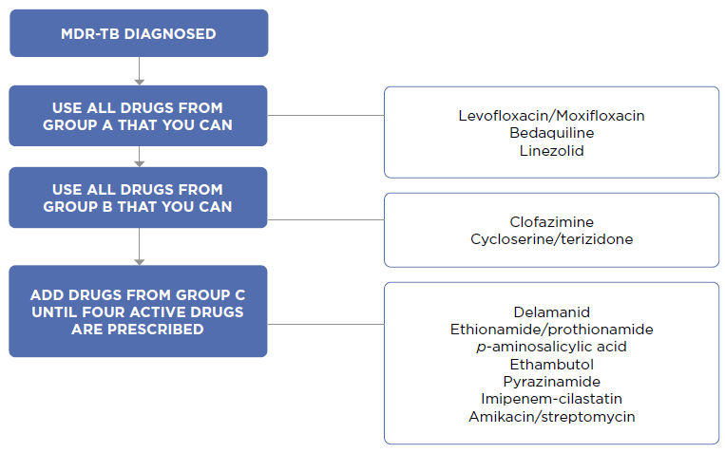
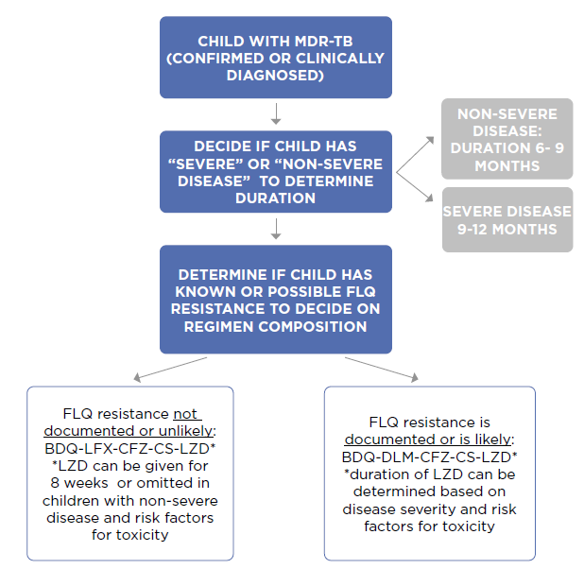
Treatment regimen for RR/MDR-TB
Notes:
It also lists how to construct a regimen and includes the most commonly used regimen for children (<16 years) who are not yet eligible for the 6-month BPaL(M) regimen as pretomanid is not yet recommended for children.
The usual drugs will be at least a four-drug combination of bedaquiline, levofloxacin, linezolid, and clofazimine or cycloserine – and duration may depend on severity – 6-9 months if non-severe and 9-12 months if severe. If there is fluoroquinolone resistance, delamanid can replace levofloxacin.

Slide 39
Conclusion
Summary of key points

Slide 40
Summary of key learning points
Choice of treatment regimen depends on age, site of disease, severity of disease and drug susceptibility.
Follow NTP guidelines for choosing the correct regimen.
Weight is critical for correct drug dosage and to monitor treatment response.
Treatment of RR/MDR-TB should be all-oral and choice of regimen determined by known drug resistance or exposure to drug resistant profile.
Treatment support and education that is age-appropriate is critical (Module 5).
Children tolerate treatment well and treatment outcomes are usually satisfactory.
TB treatment should always be registered and should be continued for the full course of treatment as per NTP guidance.
Notes:
Choice of treatment regimen depends on age, site of disease, severity of disease and drug susceptibility
Follow NTP guidelines for choosing the correct regimen
Weight is critical for correct drug dosage and to monitor treatment response
Treatment of MDR TB should be all-oral and choice of regimen determined by known drug resistance or exposure to drug resistant profile
Treatment support and education that is appropriate to the age and development of the child or adolescent is critical and covered in more detail in module 5
Children tolerate treatment well and treatment outcomes are usually satisfactory
TB treatment should always be registered and should be continued for the full course of treatment as per NTP guidance

Slide 41
Challenge your knowledge

Slide 42
Quiz question 1
Regarding the treatment of children and adolescents for TB, which of the following is FALSE?
TB drugs are well tolerated at recommended dosages in both children and adolescents.
The first consideration in the decision to start the child or adolescent on TB treatment should be whether they require inpatient care or are at risk for severe disease.
When available, CXR is an important tool in determining the choice of treatment regimen for children and adolescents with TB.
Adolescents, unlike young children do not have many challenges to treatment adherence and so do not usually require additional social support.

Slide 43
Quiz question 1 - answer
Regarding the treatment of children and adolescents for TB, which of the following is FALSE?
TB drugs are well tolerated at recommended dosages in both children and adolescents.
The first consideration in the decision to start the child or adolescent on TB treatment should be whether they require inpatient care or are at risk for severe disease.
When available, CXR is an important tool in determining the choice of treatment regimen for children and adolescents with TB.
Adolescents, unlike young children do not have many challenges to treatment adherence and so do not usually require additional social support.

Slide 44
Quiz question 2
Which of the following statements concerning shortened regimens for treating tuberculosis in children and adolescents is FALSE?
A four-month regimen consisting of rifampicin, isoniazid pyrazinamide and ethambutol can be used to treat children from 3 months to 15 years with non-severe pulmonary TB.
A shorter four-month regimen consisting of rifapentine, and moxifloxacin may be used to treat TB in children older than 12 years regardless of HIV status or disease severity.
A shorter six-month regimen consisting of high dose isoniazid, rifampicin and ethionamide may be used to treat TB meningitis in children and adolescents.
A four-month regimen consisting of rifampicin, isoniazid, pyrazinamide and ethambutol may be used to treat children younger than 3 months if severe presentations of TB (e.g., meningitis or miliary disease) are ruled out.

Slide 45
Quiz question 2 - answer
Which of the following statements concerning shortened regimens for treating tuberculosis in children and adolescents is FALSE?
A four-month regimen consisting of rifampicin, isoniazid pyrazinamide and ethambutol can be used to treat children from 3 months to 15 years with non-severe pulmonary TB.
A shorter four-month regimen consisting of rifapentine, and moxifloxacin may be used to treat TB in children older than 12 years regardless of HIV status or disease severity.
A shorter six-month regimen consisting of high dose isoniazid, rifampicin and ethionamide may be used to treat TB meningitis in children and adolescents.
A four-month regimen consisting of rifampicin, isoniazid, pyrazinamide and ethambutol may be used to treat children younger than 3 months if severe presentations of TB (e.g., meningitis or miliary disease) are ruled out.

Slide 46


